Slide 1
Git Commands

Slide 2
Table of Contents
Life Cycle of Git
Basic Git Commands
Git Overview
Version Control
Solving Merge Conflicts
Why do we need Version Control?
Demo
Business Problem

Slide 3
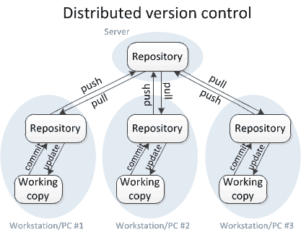
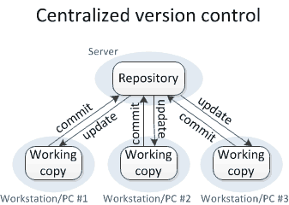
Version Controls
Version Control System is a software that automatically maintains a record of every change in a project. There are two types of Version Control Systems.

Slide 4



Why Do we need Version Control?
Improve Visibility
Accelerated Product Delivery
Cross Team Collaborations

Slide 5
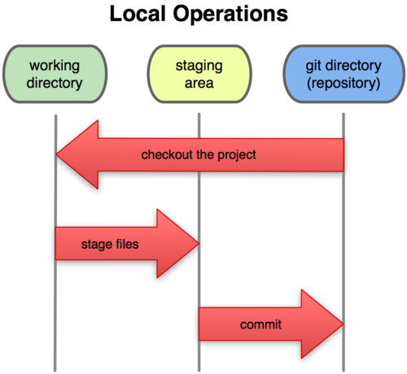
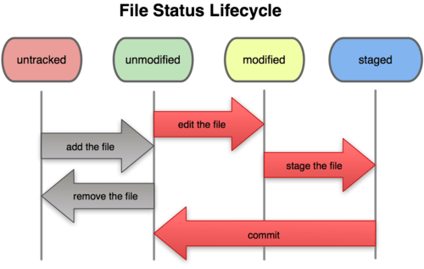
Git Overview
Git is the most used Distributed Version Control System. It keeps a record of every change in a project by taking snapshots. It means that you can easily roll back to any previous version/state of a project.
Three staged Architecture
Git File Life Cycle

Slide 6
Basic Git Command
Git Status - Git Status – command lists all the files that have to be committed.
Syntax: git status
Git init – Initialize the git repository .
Syntax: git init
Git Config – configure the name and email id to use in commits.
Syntax: git config –global user.name”[name]”
Example:
git config –global user.name “Dhruv”

Slide 7
Basic Git Command
Git Add – Adds a file to the staging area
Syntax: git add [file], git add –a, git add .
Example:
git add demo_text.py
Git Commit – Records or Snapshots the file permanently in the version history.
Syntax: git commit –m “[ Type in the commit message]”
Example:
git commit –m “ my first project version”

Slide 8
Basic Git Command
Git Remote – It will check if we have any remote repository.
Syntax : git remote
To add a remote repository:
Syntax : git remote add <name><url>
Git Push – It will push files and folder to remote repository that is hosted on github.
Syntax : git push<name><branch>
Example : git push origin master

Slide 9
Basic Git Command
Git diff – shows the file differences which are not yet staged
Syntax: git diff <filename> / git diff / git diff --staged
Example:
git diff first_project.py
Git reset – Unstage the file but it preserves the file content.
Syntax: git reset [file] – Unstage the file
git reset [commit] – Undo the commits after the specified commit and preserves the changes locally.
git reset –hard[commit] - discards all history and goes back to the specified commit.

Slide 10
Basic Git Command
Skipping Staging area – you can skip staging area and directly commit file from working directory to git folder.
Syntax: git commit –a –m “message”
Example:
git commit –a –m “skipping staging area”
Gitignore – it is a file in which if you specify something it will be ignored by git.

Slide 11
Basic Git Command
Git Clone – obtain a repository from an existing URL
Syntax: git clone <url>
Example:
git clone https://
Git Pull – you can pull the code from remote repo hosted on url
Syntax : git pull

Slide 12
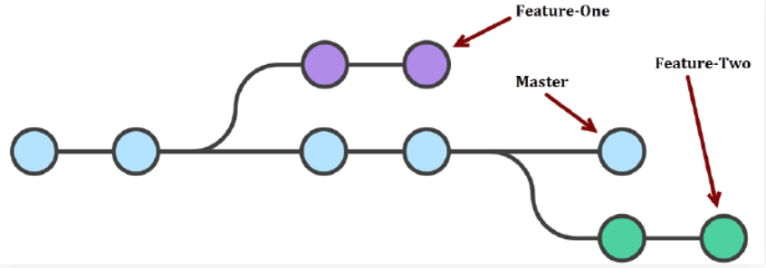
Git Branch
To create a new branch:
To make any changes:
git branch <branch_name>
git checkout <branch_name>
To delete a branch:
git checkout -d <branch_name>

Slide 13
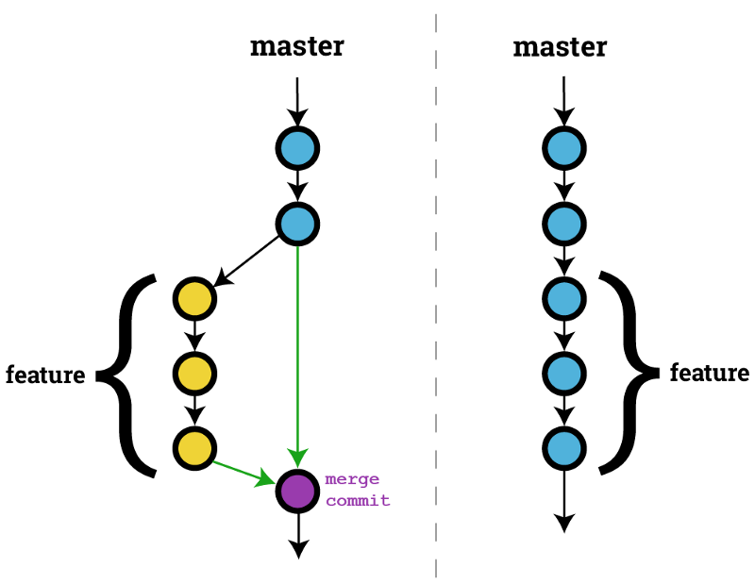
Git Merge
Git Merge : It merges two branches into a single branch
Syntax : git merge <branch_name>
Example : git merge dev

Slide 14

Thank you
Kamesh Srinivasan
Director, ITA-South
KPMG in India
T: +91 974 216 6033
E: kamesh@kpmg.com
Shalendra Daga
Associate Director, ITA-North KPMG in India
T: +91 981 181 6868
E: shalendradaga@kpmg.com
Follow us on:
kpmg.com/in/socialmedia
The information contained herein is of a specific purpose for Adani and confidential in Nature. This proposal is subject to KPMG’s risk clearance and approvals without which this does not stand valid.
Although we endeavour to provide accurate and timely information, there can be no guarantee that such information is accurate as of the date it is received or that it will continue to be accurate in the future. No one should act on such information without appropriate professional advice after a thorough examination of the particular situation.
© 2018 KPMG, an Indian Registered Partnership and a member firm of the KPMG network of independent member firms affiliated with KPMG International Cooperative (“KPMG International”), a Swiss entity. All rights reserved.
The KPMG name and logo are registered trademarks or trademarks of KPMG International.
This document is for e-communications only.
Anish Mitra
Manager, ITA-South
KPMG in India
T: +91 894 000 0829
E: anishmitra@kpmg.com

